Slide 1
M2F
(Make To Fix)
Uxplorers 25
Dept of Information Technology
Team Members
Ajaykumar SK
Ajay S
Dheenadhayalan S
Gowrisankar J

Slide 2

IDEA OF THIS PROJECT
Project idea : Build a platform for the home service User and Servicer partner
To make the household works easier.
Innovative feature: A dedicated community for apartment residents and daily service seekers. With help of community column.
Project motive: To provide a service for the user in low marginal price and provide a quality of work to the User

Slide 3
NUMBER OF LOGINS
USER LOGIN
SERVICE PARTNER
CUSTOMER SUPPORT
ADMIN LOGIN
01
02
03
04

Slide 4
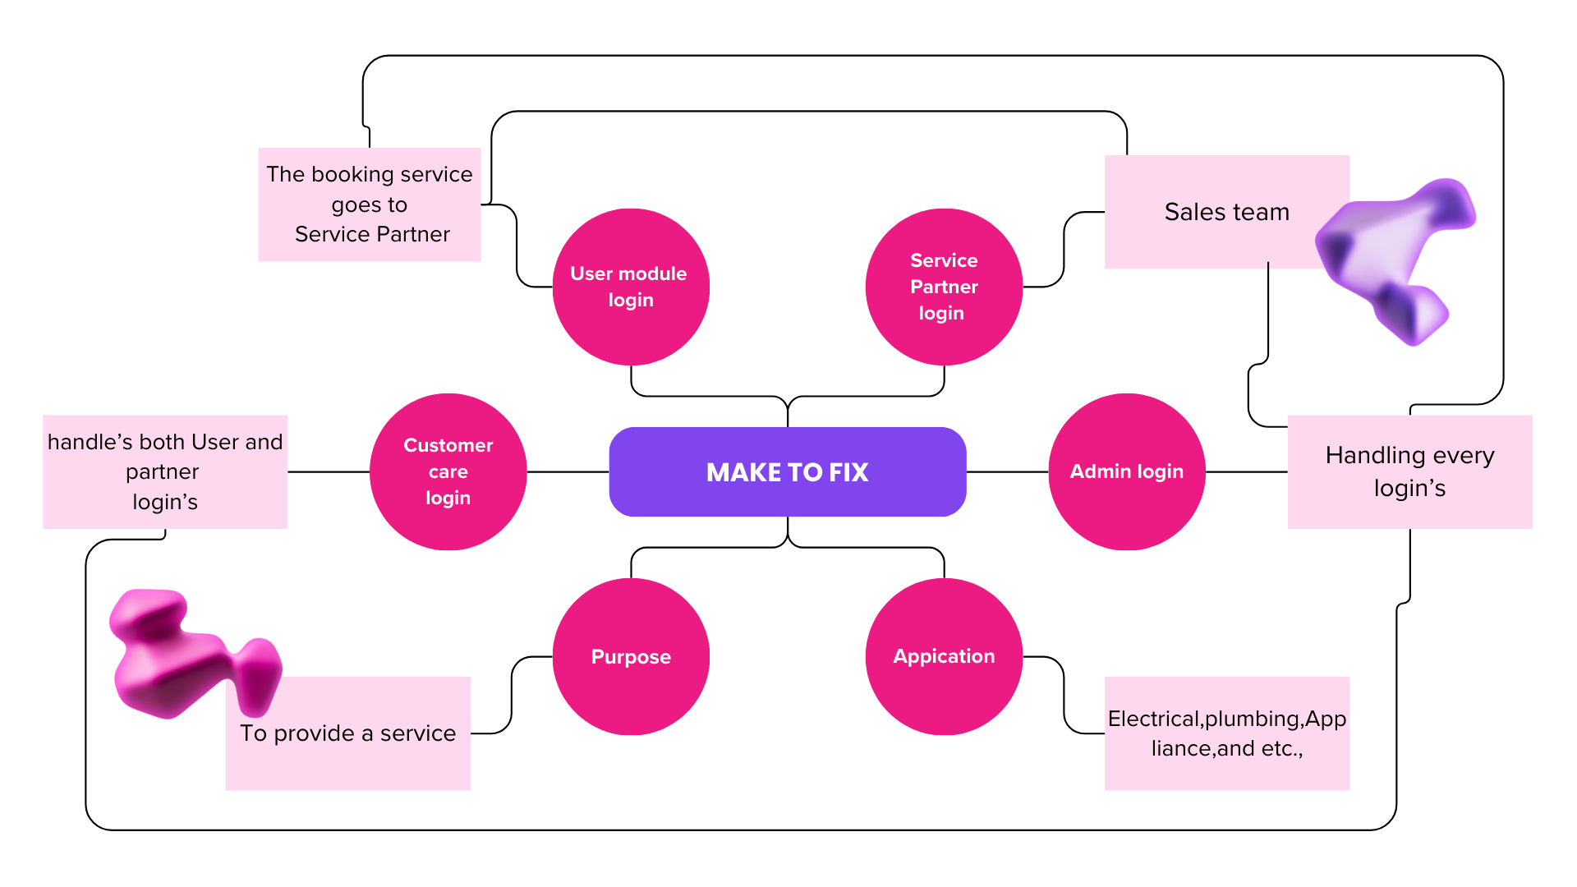
FLOW DIAGRAM OF MAKE TO FIX

Slide 5
USER LOGIN
01
Purposes of user login
Its provide services like Plumbing, electrical, beauty salon, cleaning and appliances repair services
It also Includes community page with community joining
This login also provide user centric functions like adding items to cart and payment of the services and also gives the live tracking option

Slide 6
SERVICE PROVIDER LOGIN
02
Purposes of Service provider login
This login is used by the service provider and this login provides the complete instructions provided to the service provider about the services
Service provider can login with the tutorial videos for the learning how they going to work on customer place
The provider can also see there profile and per day or week summary of services which they taken and also see there feedback given by the customers

Slide 7
CUSTOMER SERVICE LOGIN
03
Purposes of Customer service login
This login is used by the support team for the service provider and the customers
The login is mainly used as the customer should be satisfied without any issues if any issues arises means the support team can appear
Not only for the user it also gives the support to the service providers with any issues related to the payment or issues with the c

Slide 8
ADMIN LOGIN
04
Purposes of ADMIN login
The admin is the main login for the backend team which specifies all the logins such as User, Service provider and customer services
It also specifies what is going to show on user login and service provider login page and also generate the task to the service provider which ordered by user
Admin page as controlled by backend team as the company interacts with the user

Slide 9

TARGET AUDIENCE
Apartment Residents
Independent House Owners
Tenants & Landlords
Senior Citizens
Office & Commercial Space Owners

Slide 10





HOW IT WORKS
User Registration
Book Services
Community Join
Payment &Tracking
Feedback

Slide 11

Project Status
User Module is deployed Website name m2f.shop
Service partner is made up of prototype
Care pages are in format of UI design
Admin pages are in format of UI design

Slide 12
—Bharathiyar
“ You don't get anything clean without getting something else dirty.So, clean the dirty with us”

Slide 13
Question Time
Website url : (m2f.shop)
As per the presentation the make to fix is end to end project
Fell Free to as a Question about the project.

